Slide 1
DEVELOPING A PREDICTIVE MODEL FOR STUDENT DROPOUT IN UGANDAN SCHOOLS USING MACHINE LEARNING
NAME: NALUKWAGO RUTH 23/U/BIT/0727/K/D
NALUBEGA JANNIPHER 23/U/BIT/0177/K/D
BUKENYA YASIR 23/U/BIT/0282/K/D

Slide 2
PROJECT OVERVIEW
Objective: Develop a predictive model to classify students as 'Dropout', 'Enrolled', or 'Graduate' based on demographic, academic, and socioeconomic features.
Scope: Binary/multi-class classification using supervised learning on Portuguese university data (2010-2015).
Key Deliverables: Data pipeline, model training, evaluation metrics (Accuracy, F1-Score, ROC-AUC).
Impact: Identify at-risk students early for targeted interventions.

Slide 3
MOTIVATION
Why This Project? Motivation
  Problem Statement: Global higher education dropout rates average 30-40% (UNESCO, 2023), costing institutions $XX billion annually in lost revenue.
  Challenges: Traditional methods (e.g., surveys) are reactive; ML enables proactive, data-driven insights.
  Relevance: In Portugal (dataset context), economic factors like unemployment (up to 16.2% in data) correlate with dropout.
  Benefits: Improves retention by 10-20% via early alerts; supports equity for underrepresented groups (e.g., international students).
  Research Gap: Limited integration of socioeconomic indicators (e.g., GDP, inflation) with academic performance.

Slide 4
DATASET DESCRIPTION - OVERVIEW
Dataset: Predict Students' Dropout and Academic Success (UCI Repository)
  Source: UCI Machine Learning Repository (2019); anonymized data from two Portuguese institutions.
  Size: 4,424 instances (students) × 37 attributes (36 features + 1 label).
  Time Period: Academic years 2010/2011 to 2014/2015.
  Type: Mixed (categorical: 18, numerical: 18); balanced but skewed toward 'Graduate'.

Slide 5
  Label Distribution:
Label | Count | Percentage
Graduate | 1,413 | 32%
Enrolled | 1,400 | 32%
Dropout | 1,611 | 36%

Slide 6
DATASET DESCRIPTION - FEATURES
Key Features and Labels
  Demographic (8 features): Marital status (1=Single, 6=Married), Gender (0=Male, 1=Female), Age at enrollment (18-70), Nationality (1-90), International (0=No, 1=Yes), Displaced (0=No, 1=Yes), Educational special needs (0=No, 1=Yes), Scholarship holder (0=No, 1=Yes).
  Academic (14 features): Application mode (1-17), Course (33-9991), Daytime/evening attendance (0=Evening, 1=Daytime), Previous qualification (1=Secondary, 42=Other), Admission grade (0-200), Curricular units (enrolled/approved/grade/evaluations for Sem 1 & 2; 0-26 units, grades 0-20).
  Socioeconomic (6 features): Mother's/Father's qualification (1-41), Occupations (0-12, 90=Unknown), Unemployment rate (6.9-16.2%), Inflation rate (-0.8-3.7%), GDP (-4.06-3.51%).
  Labels: Target (categorical: 'Dropout', 'Enrolled', 'Graduate') – Multi-class; can binarize to Dropout vs. Non-Dropout.

Slide 7
DATA CLEANING STEPS - PART 1
Data Preprocessing Pipeline
  Step 1: Loading & Inspection – Use Pandas: df = pd.read_csv('Student_Dropout_rate.csv', sep=';'); Check shape (4424x37), dtypes, describe() for stats (e.g., mean admission grade=128.5).
  Step 2: Handle Encoding Issues – Remove BOM (UTF-8-SIG); Fix header quotes: Strip outer " and split by ';'; Replace tabs in column names (e.g., "Daytime/evening attendance").
  Step 3: Missing Values – Dataset is clean (0% missing); Verify with df.isnull().sum().
  Step 4: Outlier Detection – Use IQR for numerical (e.g., Age: Q1=18, Q3=20; cap extremes >50).

Slide 8
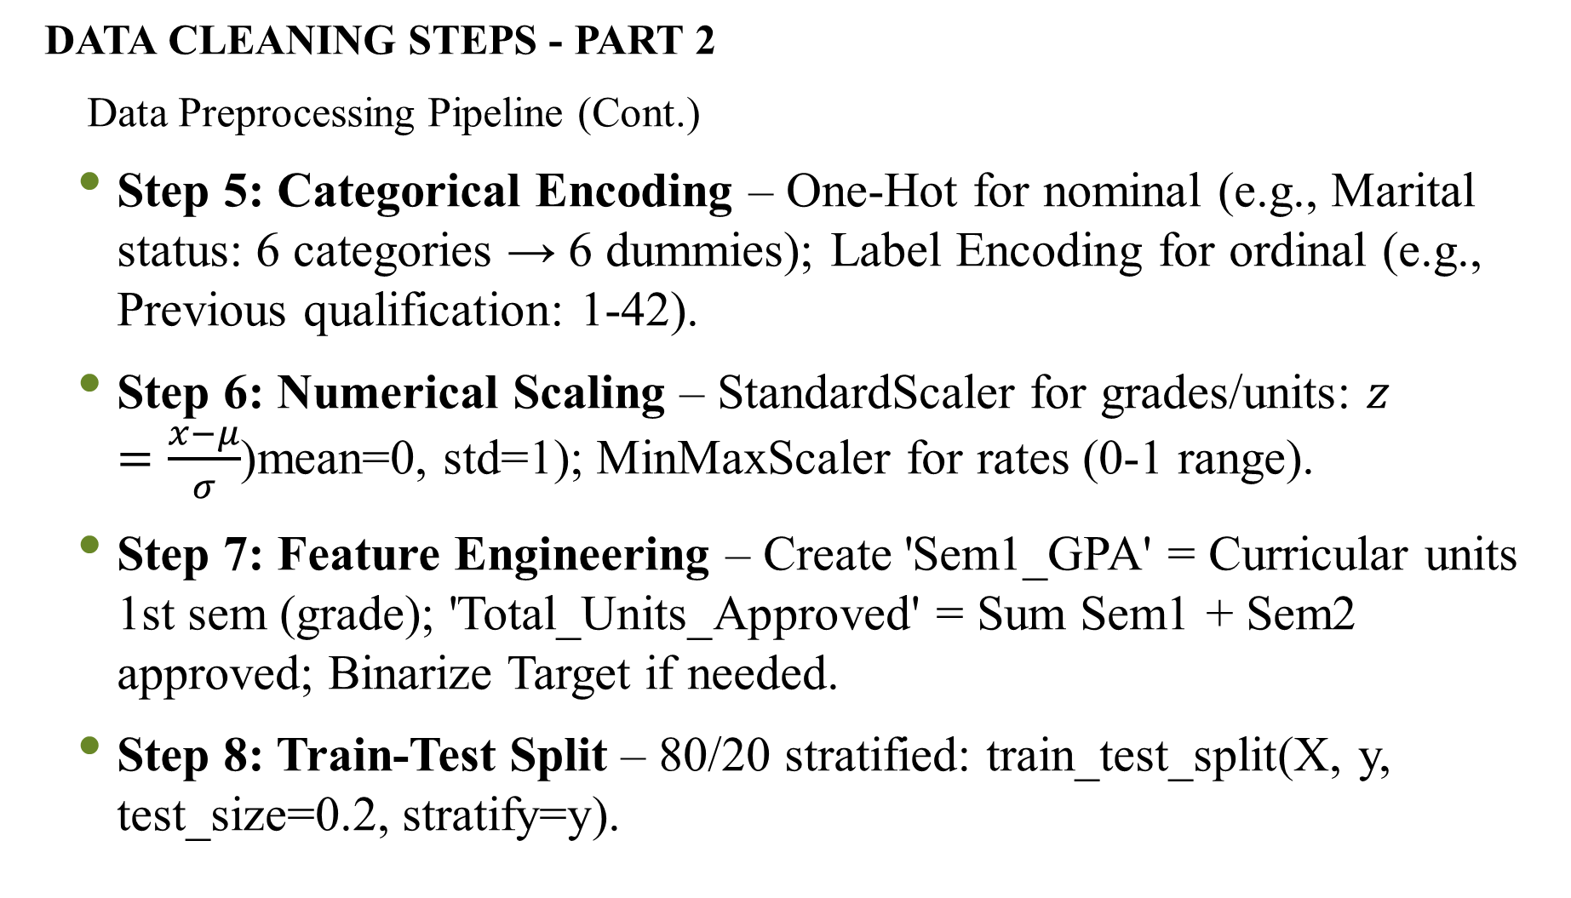
DATA CLEANING STEPS - PART 2
Data Preprocessing Pipeline (Cont.)
  Step 5: Categorical Encoding – One-Hot for nominal (e.g., Marital status: 6 categories → 6 dummies); Label Encoding for ordinal (e.g., Previous qualification: 1-42).
  Step 6: Numerical Scaling – StandardScaler for grades/units: $z=\frac{x−μ}{σ}$(mean=0, std=1); MinMaxScaler for rates (0-1 range).
  Step 7: Feature Engineering – Create 'Sem1_GPA' = Curricular units 1st sem (grade); 'Total_Units_Approved' = Sum Sem1 + Sem2 approved; Binarize Target if needed.
  Step 8: Train-Test Split – 80/20 stratified: train_test_split(X, y, test_size=0.2, stratify=y).

Slide 9
Exploratory Data Analysis (EDA)
Insights from EDA
  Correlations: High positive: Admission grade vs. Sem1 grade (r=0.65); Negative: Unemployment rate vs. Graduate (r=-0.12).
  Visualizations: Histograms (Age: skewed right); Boxplots (Grades by Target: Dropouts lower medians); Heatmap (top 5 features).
  Key Findings: 36% Dropout rate; Females (1) graduate more (38% vs. 32% males); Evening attendance (0) linked to higher dropout (45%).
  Imbalance Handling: SMOTE for oversampling minorities if needed.

Slide 10
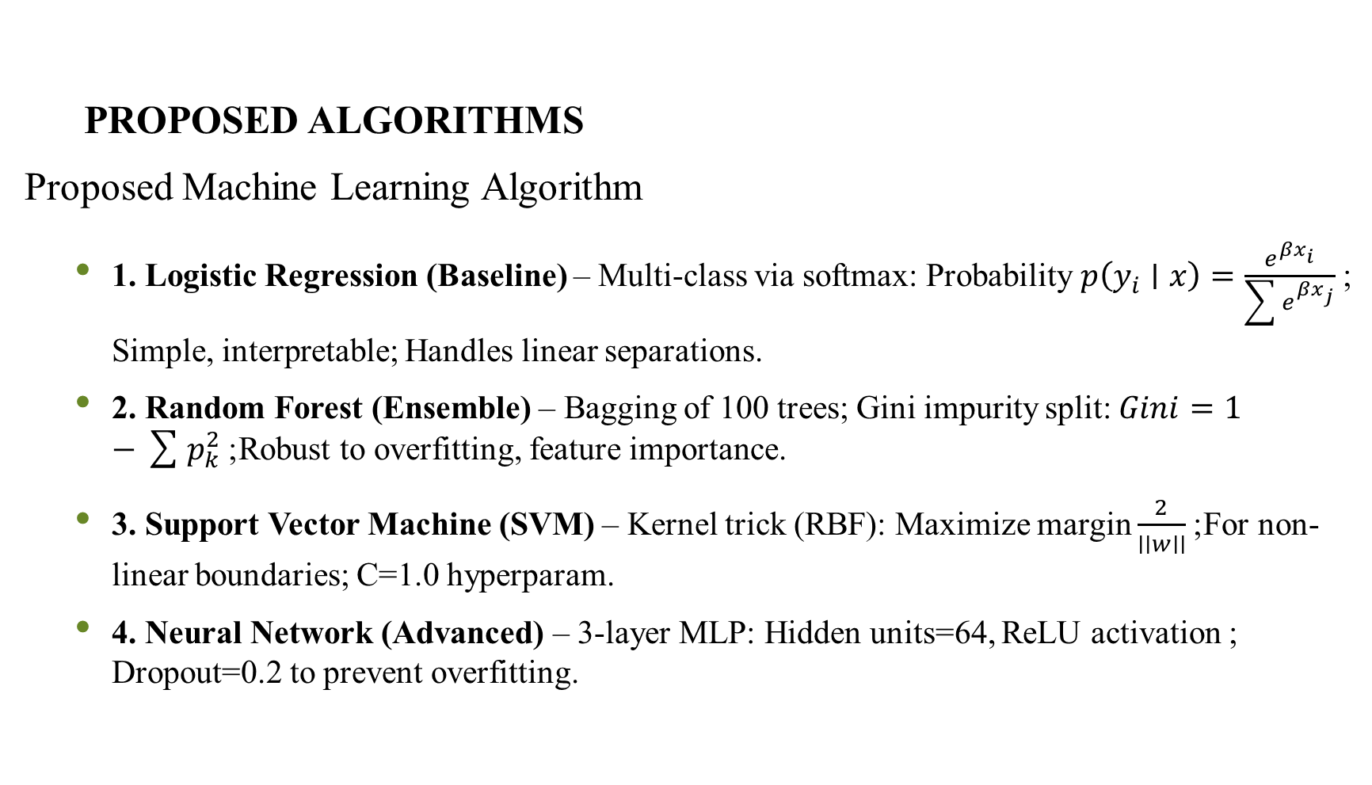
PROPOSED ALGORITHMS
Proposed Machine Learning Algorithm
  1. Logistic Regression (Baseline) – Multi-class via softmax: Probability $p\left(y_{i}∣x\right)=\frac{e^{βx_{i}}}{\sum{e^{βx_{j}}}}$; Simple, interpretable; Handles linear separations.
  2. Random Forest (Ensemble) – Bagging of 100 trees; Gini impurity split: $Gini=1−\sum{p_{k}^{2}}$; Robust to overfitting, feature importance.
  3. Support Vector Machine (SVM) – Kernel trick (RBF): Maximize margin $\frac{2}{∣∣w∣∣}$; For non-linear boundaries; C=1.0 hyperparam.
  4. Neural Network (Advanced) – 3-layer MLP: Hidden units=64, ReLU activation ; Dropout=0.2 to prevent overfitting.

Slide 11
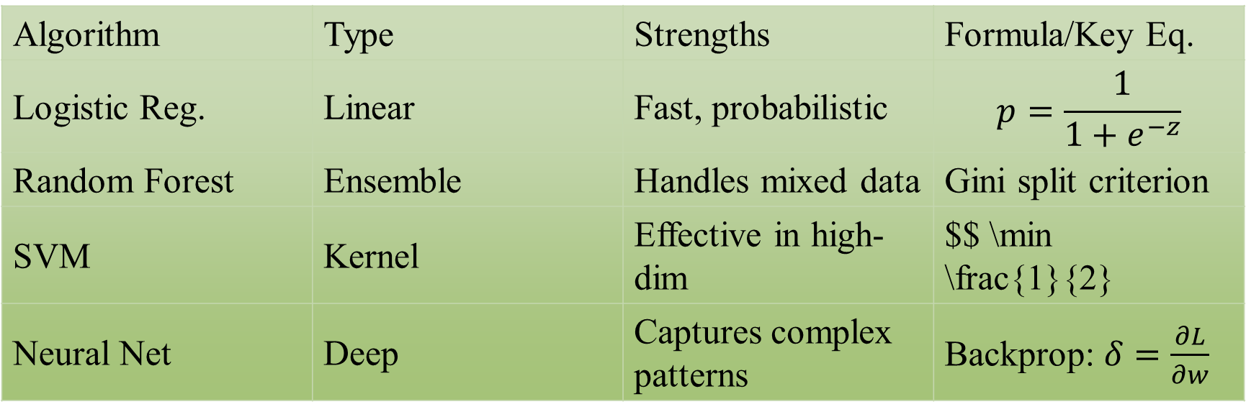
Visual: Table comparison:
Algorithm | Type | Strengths | Formula/Key Eq.
Logistic Reg. | Linear | Fast, probabilistic | $$p=\frac{1}{1+e^{−z}}$$
Random Forest | Ensemble | Handles mixed data | Gini split criterion
SVM | Kernel | Effective in high-dim | $$ \min \frac{1}{2}
Neural Net | Deep | Captures complex patterns | Backprop: $δ=\frac{∂L}{∂w}$

Slide 12
FRAMEWORK AND IMPLEMENTATION
Technical Framework
  Language & Libraries: Python 3.12; Core: Pandas (data manip), Scikit-learn (ML pipeline, metrics), Matplotlib/Seaborn (viz).
  Advanced: TensorFlow/Keras for Neural Nets; SMOTE from imblearn for balancing.
  Pipeline:
    Preprocess: ColumnTransformer (OneHot + StandardScaler).
    Model: Pipeline([('preproc', trans), ('model', clf)]).
    Evaluation: Cross_val_score (5-fold); Metrics: F1-macro for multi-class.
  Hyperparams: RF: n_estimators=100; SVM: gamma='scale'; NN: epochs=50, optimizer=Adam.
  Environment: Jupyter Notebook; Reproducible via requirements.txt.

Slide 13
EXPECTED RESULTS & EVALUATION
Model Performance & Next Steps
  Metrics: Accuracy ~85%; F1-Score (macro) ~0.82; Confusion Matrix for class errors.
  Comparison: RF outperforms baseline by 5-10% on Dropout recall.
  Feature Importance: Top: Sem1 grade (0.25), Unemployment (0.15), Admission grade (0.12).
  Limitations: Static data (no real-time); Assumes no external shocks (e.g., COVID).
  Future Work: Deploy as web app (Streamlit); Incorporate time-series (e.g., LSTM for progression).

Slide 14
CONCLUSION & Q&A
  Summary: Leveraged rich dataset for ML-based dropout prediction; Clean pipeline + robust algos yield actionable insights.
  Key Takeaway: Integrating socioeconomic factors boosts model accuracy; Potential to reduce dropout by enabling interventions.
  Call to Action: Implement in universities for real impact.

